Slide 1
OSI Data Link Layer
Network Fundamentals – Chapter 7

Slide 2
Objectives
Explain the role of Data Link layer protocols in data transmission.
Describe how the Data Link layer prepares data for transmission on network media.
Describe the different types of media access control methods.
Identify several common logical network topologies and describe how the logical topology determines the media access control method for that network.
Explain the purpose of encapsulating packets into frames to facilitate media access.
Describe the Layer 2 frame structure and identify generic fields.
Explain the role of key frame header and trailer fields including addressing, QoS, type of protocol and Frame Check Sequence.

Slide 3
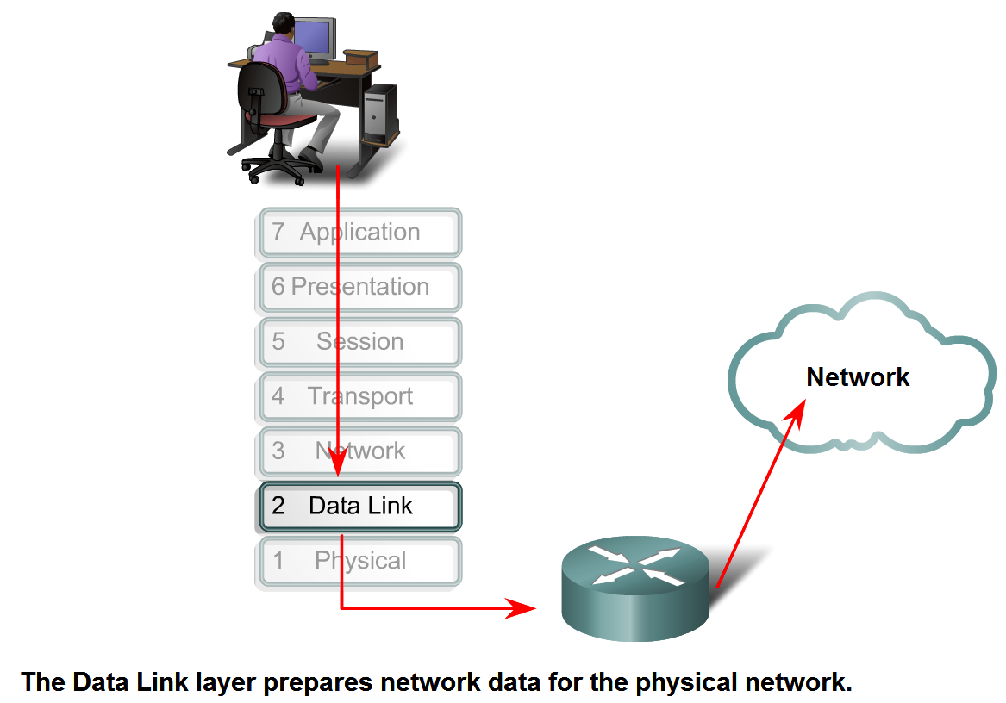
Data Link Layer – Accessing the Media
Describe the service the Data Link Layer provides as it prepares communication for transmission on specific media

Slide 4
Data Link Role
For Network layer packets to be transported from source host to destination host, they must traverse different physical networks.
These physical networks can consist of different types of physical media such as copper wires, microwaves, optical fibers, and satellite links.
Network layer packets do not have a way to directly access these different media.
It is the role of the OSI Data Link layer to prepare Network layer packets for transmission and to control access to the physical media.

Slide 5
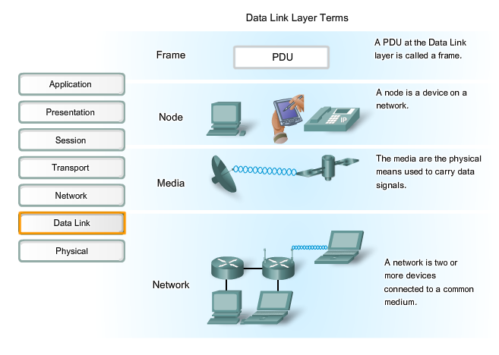
Data Link Terms

Slide 6
Layered Approach to Networking
Without the Data Link layer, a Network layer protocol, such as IP, would have to make provisions for connecting to every type of media that could exist along a delivery path.
Moreover, IP would have to adapt every time a new network technology or medium was developed.
This process would hamper protocol and network media innovation and development. This is a key reason for using a layered approach to networking.

Slide 7
Data Link Services
The range of Data Link layer services has to include all of the currently used types of media and the methods for accessing them.
Because of the number of communication services provided by the Data Link layer, it is difficult to generalize their role and provide examples of a generic set of services.
For that reason, please note that any given protocol may or may not support all these Data Link layer services.

Slide 8
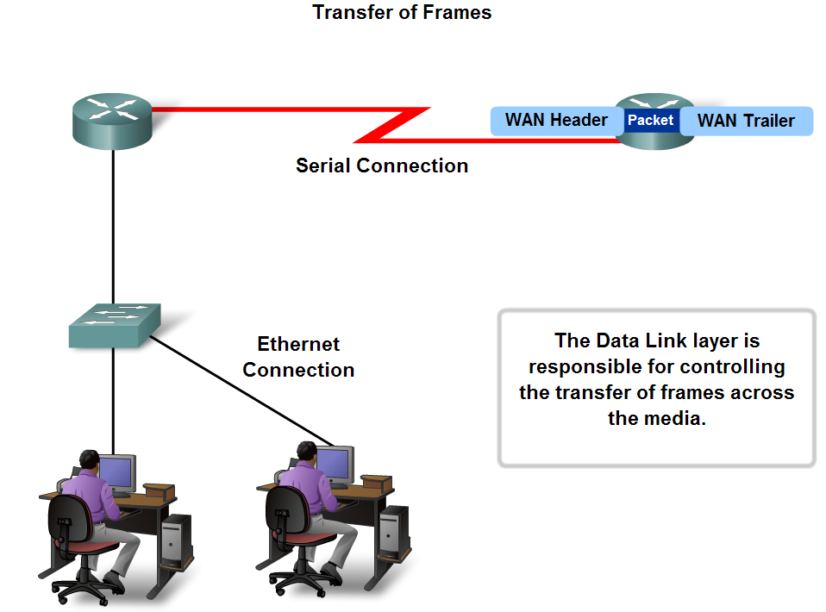
Data Link Layer – Accessing the Media
Describe the role of framing in preparing a packet for transmission on a given media

Slide 9
Media Access Control
The technique used for getting the frame on and off media is called the media access control method.
For the data to be transferred across a number of different media, different media access control methods may be required during the course of a single communication.
The media access control methods described by the Data Link layer protocols define the processes by which network devices can access the network media and transmit frames in diverse network environments.
There are two types: Deterministic and Non-Deterministic

Slide 10
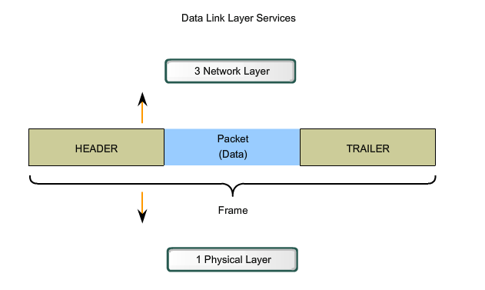
Data Link Layer Services

Slide 11
Header Information
The Data Link layer prepares a packet for transport across the local media by encapsulating it with a header and a trailer to create a frame.
The Data Link layer frame includes:
Data - The packet from the Network layer
Header - Contains control information, such as addressing, and is located at the beginning of the PDU
Trailer - Contains control information added to the end of the PDU
NB: Control information may tell:
Which nodes are in communication with each other
When communication between individual nodes begins and when it ends
Which errors occurred while the nodes communicated
Which nodes will communicate next

Slide 12
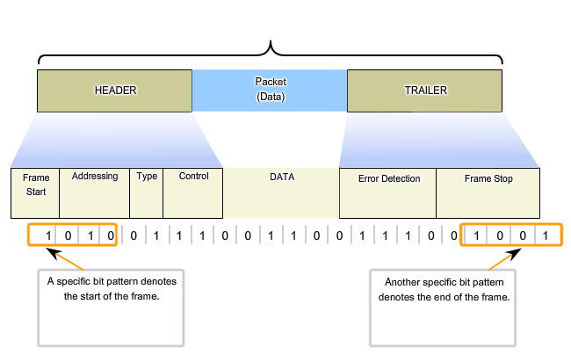
Formatting Data For Transmission

Slide 13
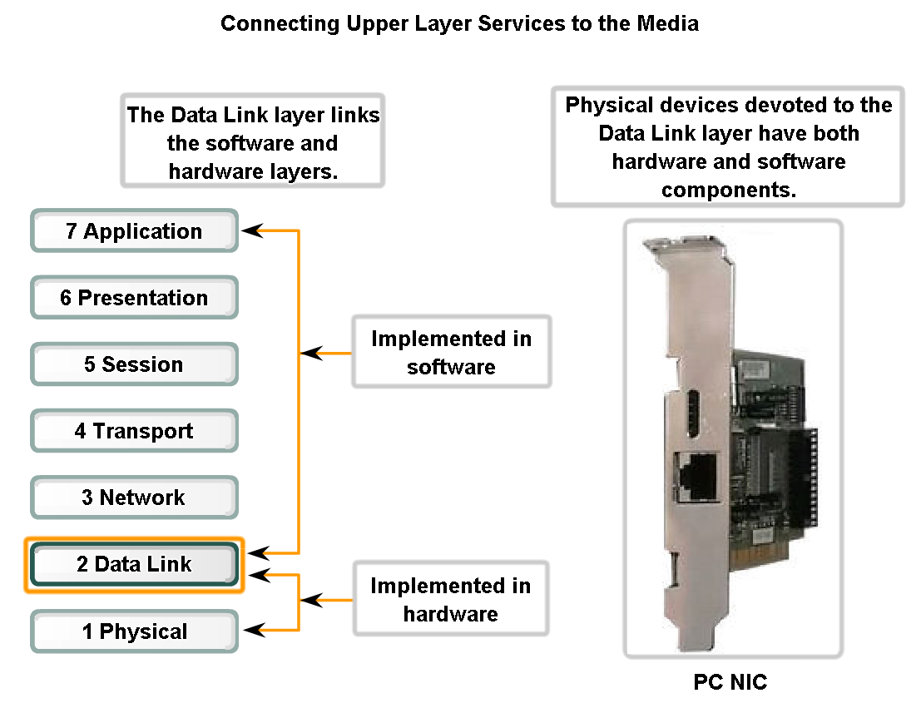
Data Link Layer – Accessing the Media
Describe the role the Data Link layer plays in linking the software and hardware layers

Slide 14
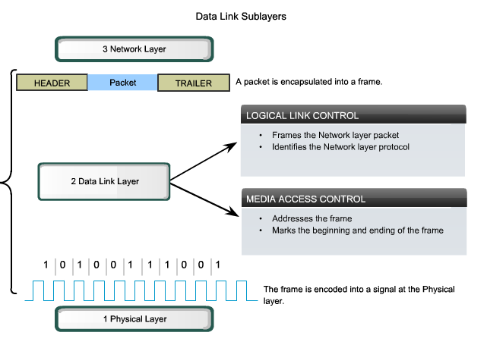
Data Link Sublayers

Slide 15
Sublayers
Separating the Data Link layer into sublayers allows for one type of frame defined by the upper layer to access different types of media defined by the lower layer.
Logical Link Control (LLC) places information in the frame that identifies which Network layer protocol is being used for the frame. This information allows multiple Layer 3 protocols, such as IP and IPX, to utilize the same network interface and media.
Media Access Control (MAC) provides Data Link layer addressing and delimiting of data according to the physical signaling requirements of the medium and the type of Data Link layer protocol in use.

Slide 16
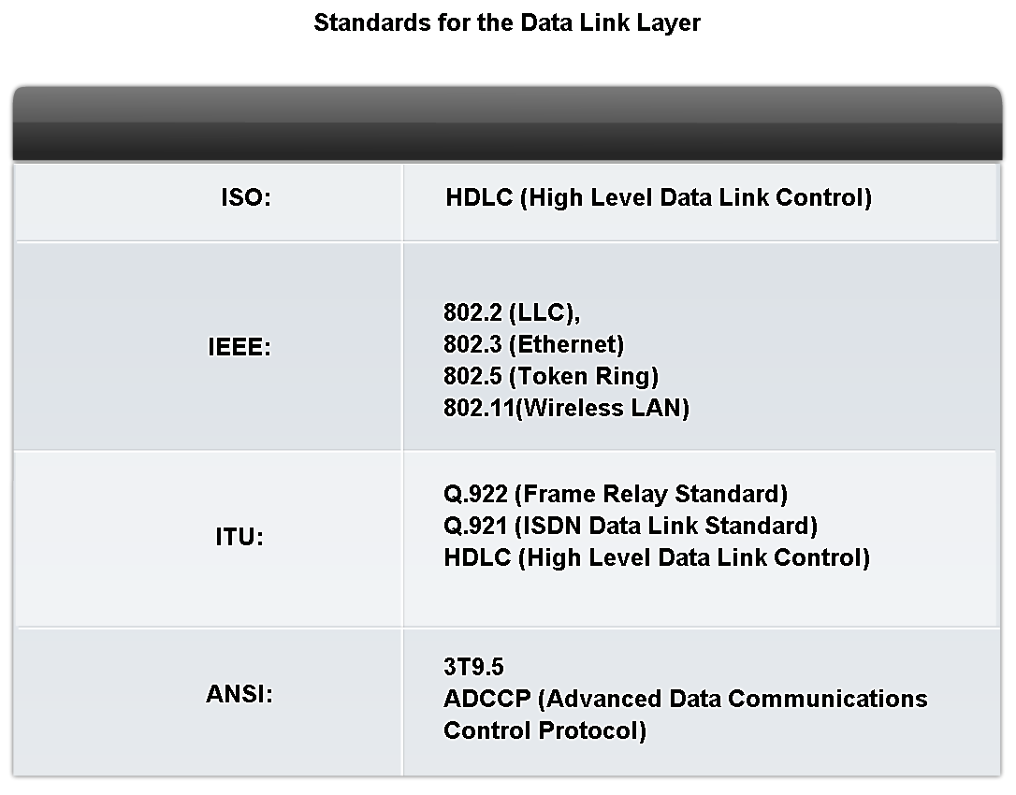
Data Link Layer – Accessing the Media
Identify several sources for the protocols and standards used by the Data Link layer

Slide 17
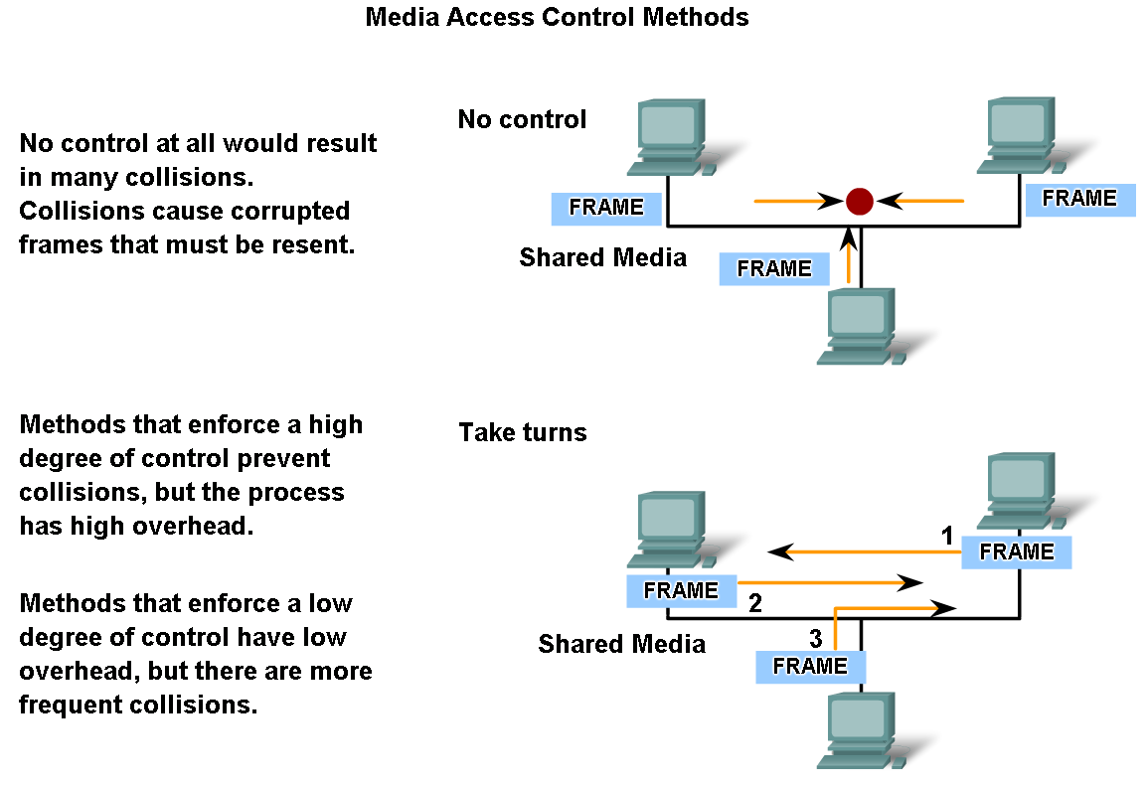
Media Access Control Techniques
Explain the necessity for controlling access to the media

Slide 18
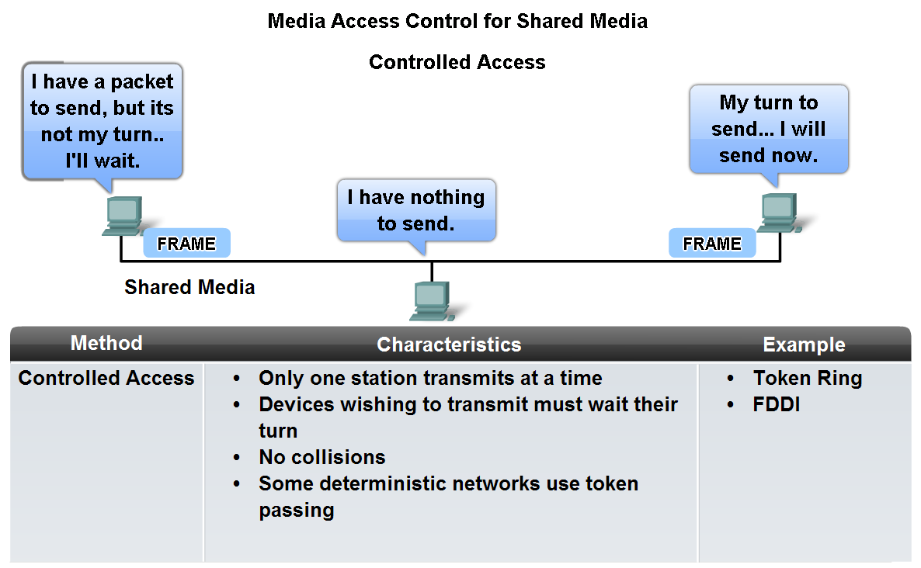
Media Access Control Techniques
Identify two media access control methods for shared media and the basic characteristics of each

Slide 19
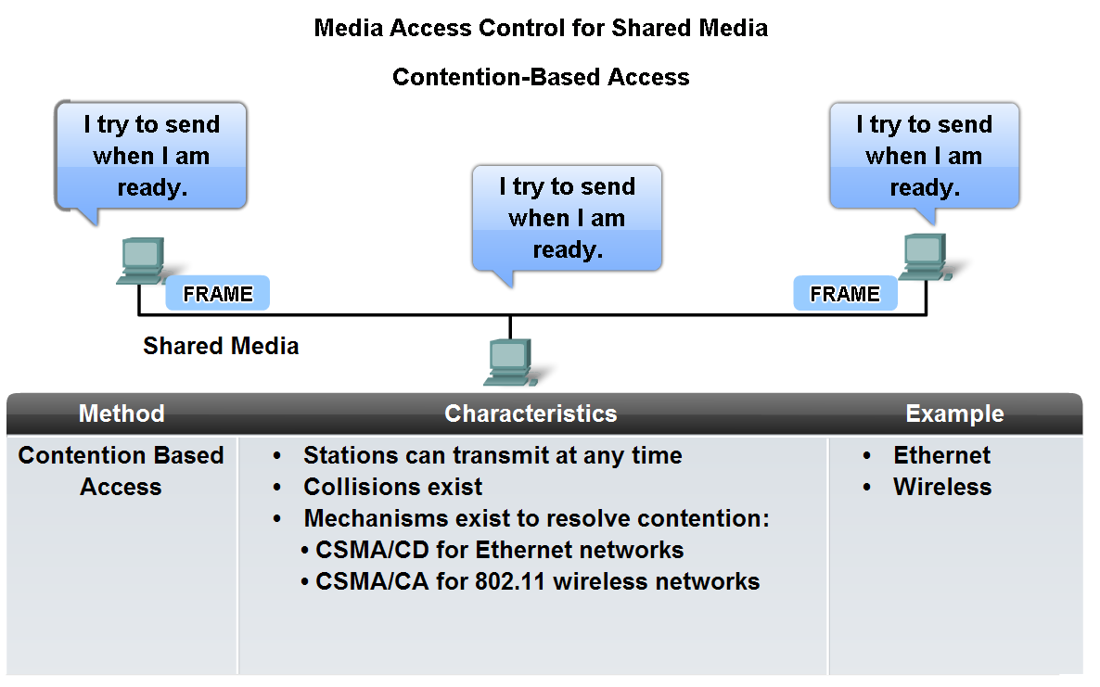
CSMA/CD and CSMA/CA

Slide 20
Controlled Access
When using the controlled access method, network devices take turns, in sequence, to access the medium.
This method is also known as scheduled access or deterministic.
If a device does not need to access the medium, the opportunity to use the medium passes to the next device in line.
When one device places a frame on the media, no other device can do so until the frame has arrived at the destination and has been processed by the destination.
Although controlled access is well-ordered and provides predictable throughput, deterministic methods can be inefficient because a device has to wait for its turn before it can use the medium.

Slide 21
Contention Based
Also referred to as non-deterministic, contention-based methods allow any device to try to access the medium whenever it has data to send.
To prevent complete chaos on the media, these methods use a Carrier Sense Multiple Access (CSMA) process to first detect if the media is carrying a signal.
If a carrier signal on the media from another node is detected, it means that another device is transmitting. When the device attempting to transmit sees that the media is busy, it will wait and try again after a short time period.
If no carrier signal is detected, the device transmits its data. Ethernet and wireless networks use contention-based media access control.

Slide 22
CSMA/CD and CSMA/CA
In CSMA/Collision Detection (CSMA/CD), the device monitors the media for the presence of a data signal. If a data signal is absent, indicating that the media is free, the device transmits the data.
If signals are then detected that show another device was transmitting at the same time, all devices stop sending and try again later. Traditional forms of Ethernet use this method.
In CSMA/Collision Avoidance (CSMA/CA), the device examines the media for the presence of a data signal.
If the media is free, the device sends a notification across the media of its intent to use it. The device then sends the data. This method is used by 802.11 wireless networking technologies.

Slide 23
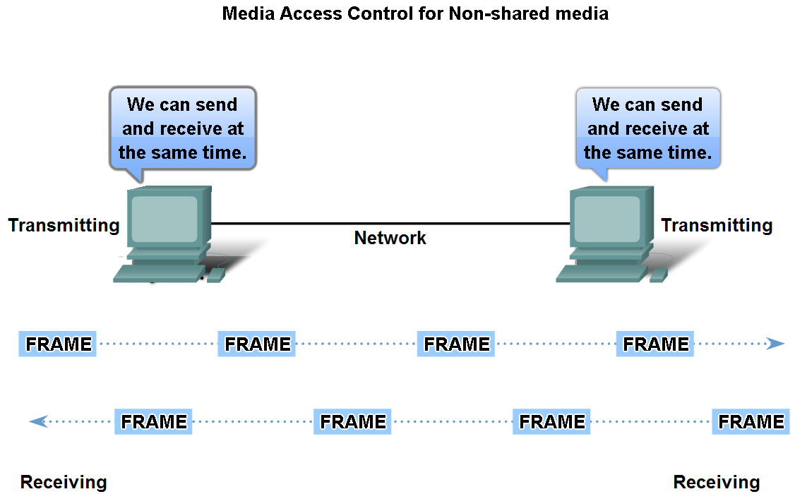
Media Access Control Techniques
Define Full Duplex and Half Duplex as it relates to Media Access Control for non-shared media

Slide 24
Half Duplex and Full Duplex
Half-duplex communication means that the devices can both transmit and receive on the media but cannot do so simultaneously.
Ethernet has established arbitration rules for resolving conflicts arising from instances when more than one station attempts to transmit at the same time.
In full-duplex communication, both devices can transmit and receive on the media at the same time.
The Data Link layer assumes that the media is available for transmission for both nodes at any time.
Therefore, there is no media arbitration necessary in the Data Link layer.

Slide 25
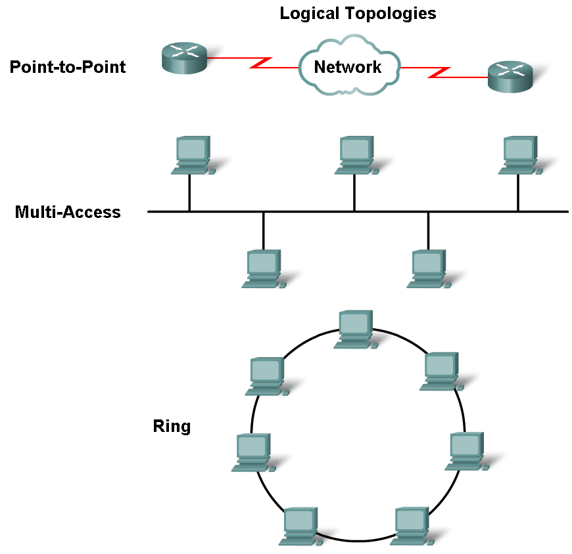
Media Access Control Techniques
Describe the purpose of a logical topology and identify several common logical topologies

Slide 26
Physical Topology
The physical topology is an arrangement of the nodes and the physical connections between them.
Logical topology of a network is closely related to the mechanism used to manage network access.
Access methods provide the procedures to manage network access so that all stations have access. When several entities share the same media, some mechanism must be in place to control access. Access methods are applied to networks to regulate this media access. Access methods will be discussed in more detail later.
Logical and physical topologies typically used in networks are:
Point-to-Point
Multi-Access
Ring

Slide 27
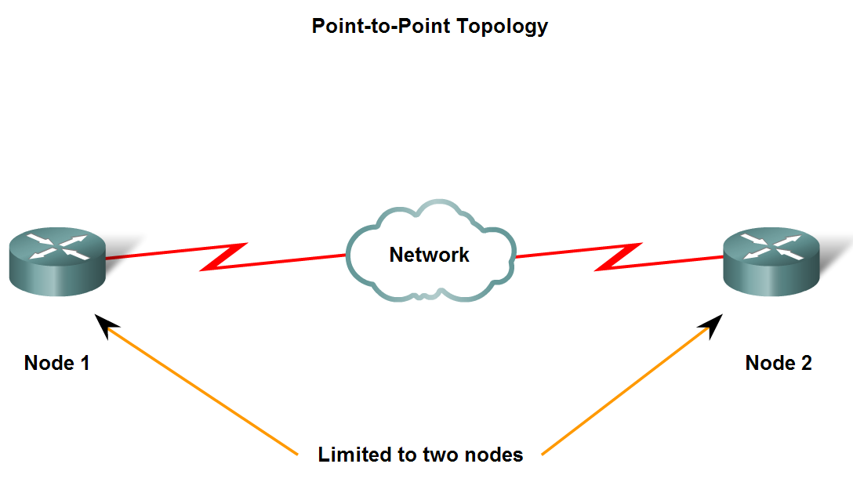
Media Access Control Techniques
Identify the characteristics of point-to-point topology and describe the implications for media access when using this topology

Slide 28
Point-to-Point
A point-to-point topology connects two nodes directly together, as shown in the figure. In data networks with point-to-point topologies, the media access control protocol can be very simple.
All frames on the media can only travel to or from the two nodes.
The frames are placed on the media by the node at one end and taken off the media by the node at the other end of the point-to-point circuit.
In point-to-point networks, if data can only flow in one direction at a time, it is operating as a half-duplex link. If data can successfully flow across the link from each node simultaneously, it is a full-duplex link.

Slide 29
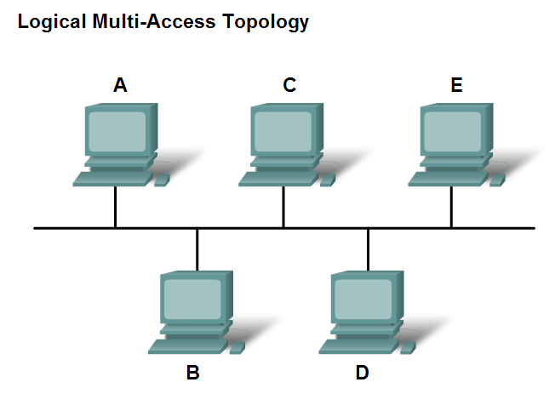
Media Access Control Techniques
Identify the characteristics of multi-access topology and describe the implications for media access when using this topology

Slide 30
Logical Multiple Access
A logical multi-access topology enables a number of nodes to communicate by using the same shared media.
Data from only one node can be placed on the medium at any one time.
Every node sees all the frames that are on the medium, but only the node to which the frame is addressed processes the contents of the frame.
The media access control methods used by logical multi-access topologies are typically CSMA/CD or CSMA/CA.
However, token passing methods can also be used.

Slide 31
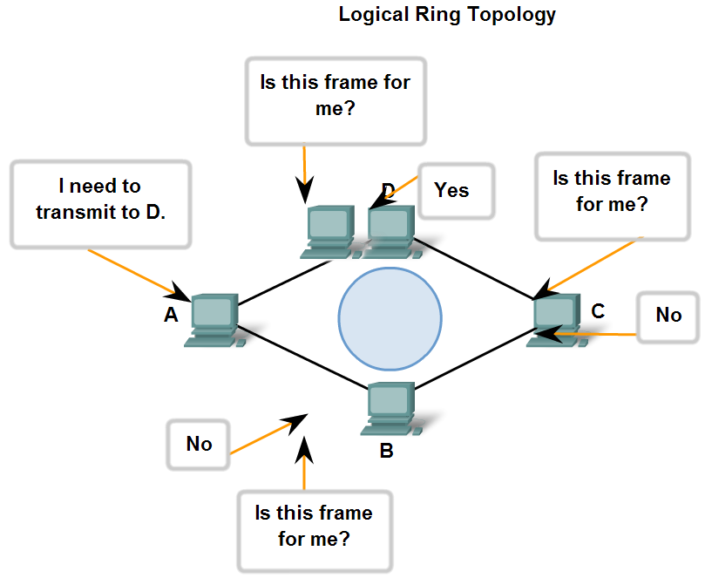
Media Access Control Techniques
Identify the characteristics of ring topology and describe the implications for media access when using this topology

Slide 32
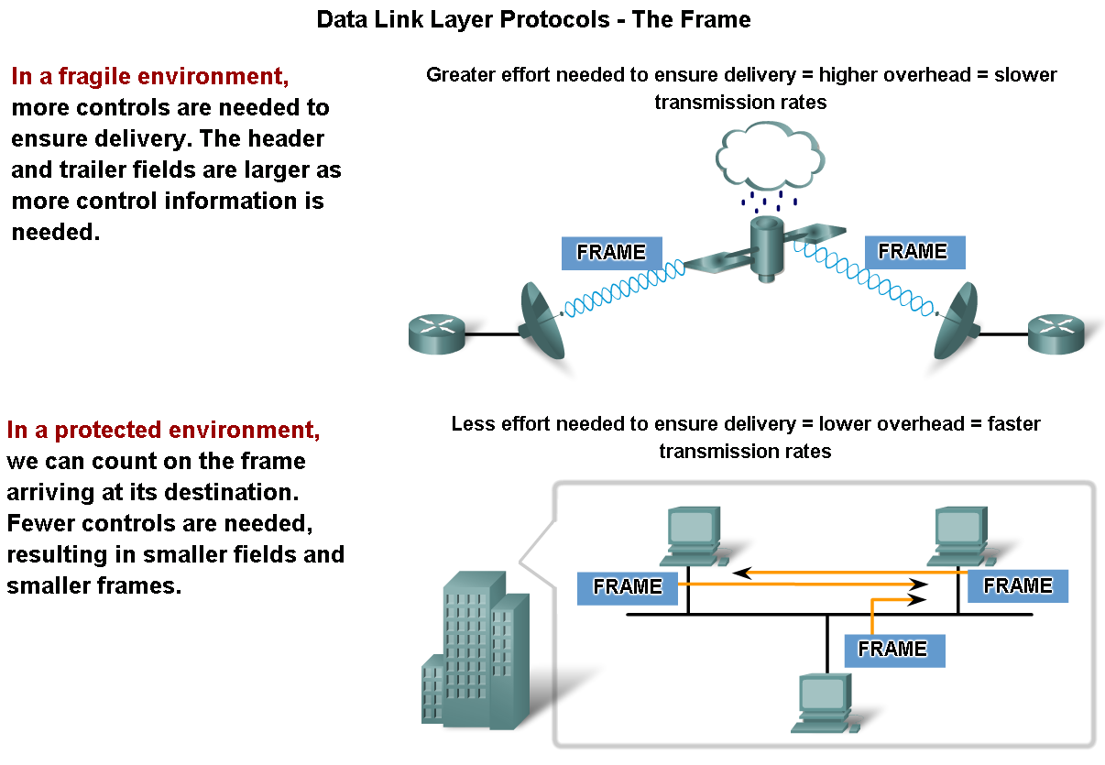
Media Access Control Addressing and Framing Data
Describe the purpose of encapsulating packets into frames to facilitate the entry and exit of data on media

Slide 33
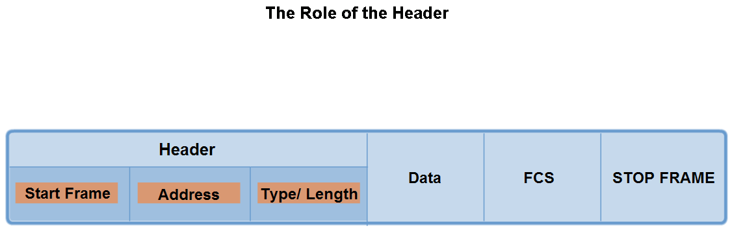
Media access control addressing and framing data
Describe the role of the frame header in the Data Link layer and identify the fields commonly found in protocols specifying the header structure

Slide 34
Frame Header Fields
Start Frame field - Indicates the beginning of the frame
Source and Destination address fields - Indicates the source and destination nodes on the media
Priority/Quality of Service field - Indicates a particular type of communication service for processing
Type field - Indicates the upper layer service contained in the frame
Logical connection control field - Used to establish a logical connection between nodes
Physical link control field - Used to establish the media link
Flow control field - Used to start and stop traffic over the media
Congestion control field - Indicates congestion in the media

Slide 35
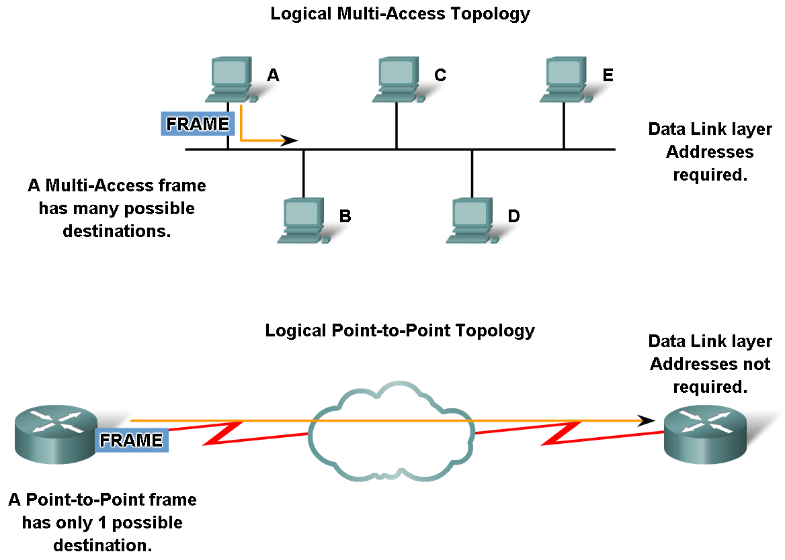
Media access control addressing and framing data
Describe the role of addressing in the Data Link layer and identify cases where addresses are needed and cases where addresses are not needed

Slide 36
Layer 2 Addressing
Because the frame is only used to transport data between nodes across the local media, the Data Link layer address is only used for local delivery.
Addresses at this layer have no meaning beyond the local network.
Compare this to Layer 3, where addresses in the packet header are carried from source host to destination host regardless of the number of network hops along the route.
If the packet in the frame must pass onto another network segment, the intermediate device - a router - will decapsulate the original frame, create a new frame for the packet, and send it onto the new segment.
The new frame will use source and destination addressing as necessary to transport the packet across the new media.

Slide 37
Addressing Requirements
The need for Data Link layer addressing at this layer depends on the logical topology.
Point-to-point topologies, with just two interconnected nodes, do not require addressing.
Once on the medium, the frame has only one place it can go.
Because ring and multi-access topologies can connect many nodes on a common medium, addressing is required for these typologies.
When a frame reaches each node in the topology, the node examines the destination address in the header to determine if it is the destination of the frame.

Slide 38
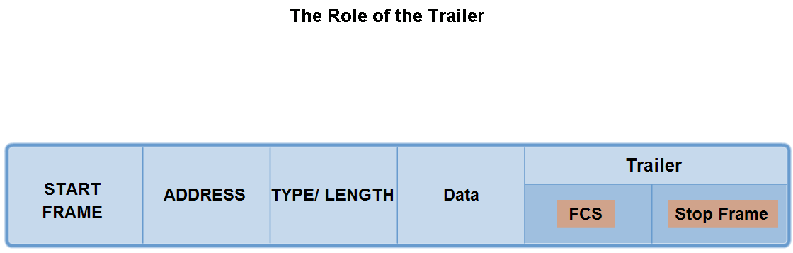
Media access control addressing and framing data
Describe the importance of the trailer in the Data Link layer and its implications for use on Ethernet, a "non-reliable" media

Slide 39
Frame Check Sequence
The Frame Check Sequence (FCS) field is used to determine if errors occurred in the transmission and reception of the frame.
Error detection is added at the Data Link layer because this is where data is transferred across the media.
The media is a potentially unsafe environment for data.
The signals on the media could be subject to interference, distortion, or loss that would substantially change the bit values that those signals represent.
The error detection mechanism provided by the use of the FCS field discovers most errors caused on the media.

Slide 40
Cyclic Redundancy Check
To ensure that the content of the received frame at the destination matches that of the frame that left the source node, a transmitting node creates a logical summary of the contents of the frame.
This is known as the cyclic redundancy check (CRC) value. This value is placed in the Frame Check Sequence (FCS) field of the frame to represent the contents of the frame.
When the frame arrives at the destination node, the receiving node calculates its own logical summary, or CRC, of the frame.
The receiving node compares the two CRC values. If the two values are the same, the frame is considered to have arrived as transmitted.
If the CRC value in the FCS differs from the CRC calculated at the receiving node, the frame is discarded.

Slide 41
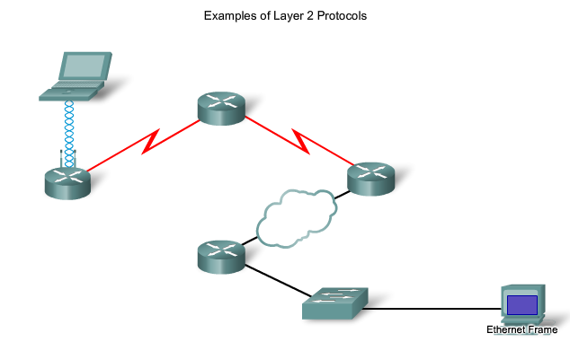
Data Link Layer Protocols

Slide 42
Data Layer Protocols
Protocols that will be covered in CCNA courses include:
Ethernet
Point-to-Point Protocol (PPP)
High-Level Data Link Control (HDLC)
Frame Relay
Asynchronous Transfer Mode (ATM)
Each protocol performs media access control for specified Layer 2 logical topologies.
This means that a number of different network devices can act as nodes that operate at the Data Link layer when implementing these protocols.
These devices include the network adapter or network interface cards (NICs) on computers as well as the interfaces on routers and Layer 2 switches.

Slide 43
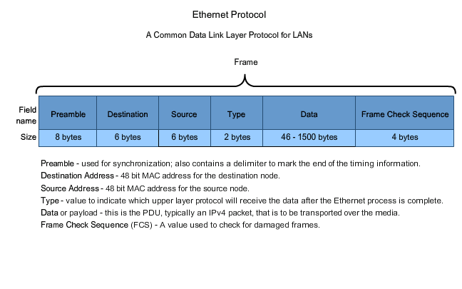
Ethernet

Slide 44
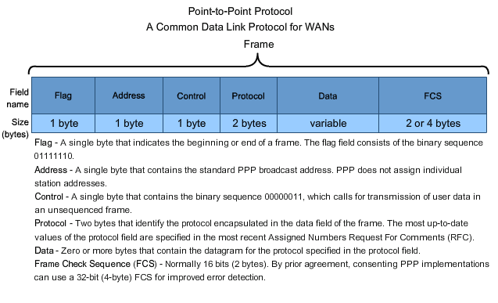
Point-to-Point

Slide 45
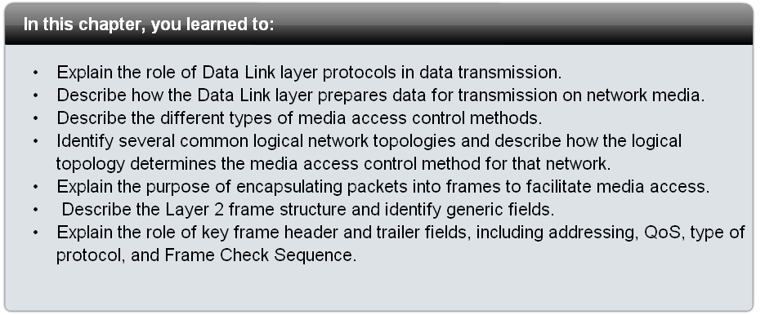
Summary

